Slide 1
Java - Library

Slide 2

The Date Class
Java provides a system-independent encapsulation of date and time in the java.util.Date class.
You can use the Date class to create an instance for the current date and time and use its toString method to return the date and time as a string.

Slide 3
The Date Class Example
For example, the following code
  java.util.Date date = new java.util.Date();
  System.out.println(date.toString());
displays a string like Tue Sep 13 14:10:19 GMT-07:00 2011

Slide 4
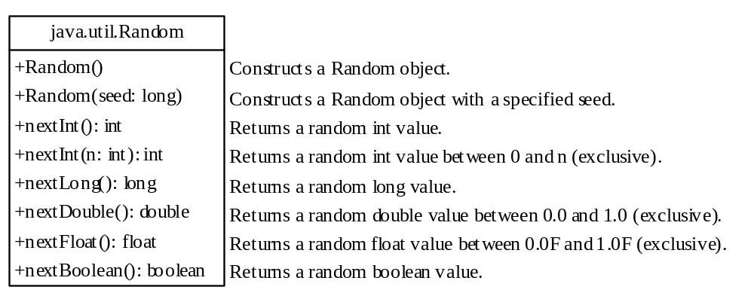
The Random Class
You have used Math.random() to obtain a random double value between 0.0 and 1.0 (excluding 1.0).
A more useful random number generator is provided in the java.util.Random class.

Slide 5
The Random Class Example
If two Random objects have the same seed, they will generate identical sequences of numbers. For example, the following code creates two Random objects with the same seed 3.
Random random1 = new Random(3);
System.out.print("From random1: ");
for (int i = 0; i < 10; i++)
System.out.print(random1.nextInt(1000) + " ");
Random random2 = new Random(3);
System.out.print("\nFrom random2: ");
for (int i = 0; i < 10; i++)
System.out.print(random2.nextInt(1000) + " ");
From random1: 734 660 210 581 128 202 549 564 459 961
From random2: 734 660 210 581 128 202 549 564 459 961

Slide 6
Example - Displaying GUI Components
When you develop programs to create graphical user interfaces, you will use Java classes such as
JFrame
JButton
JRadioButton
JComboBox
JList
to create frames, buttons, radio buttons, combo boxes, lists, and so on.
This example (TestFrame) creates two windows using the JFrame class.

Slide 7
Trace Code
Declare, create, and assign in one statement
JFrame frame1 = new JFrame(); frame1.setTitle("Window 1"); frame1.setSize(200, 150); frame1.setVisible(true);
JFrame frame2 = new JFrame(); frame2.setTitle("Window 2"); frame2.setSize(200, 150); frame2.setVisible(true);
frame1
reference
  : JFrame
title:
width:
height:
visible:

Slide 8
Trace Code
JFrame frame1 = new JFrame(); frame1.setTitle("Window 1"); frame1.setSize(200, 150); frame1.setVisible(true); JFrame frame2 = new JFrame(); frame2.setTitle("Window 2"); frame2.setSize(200, 150); frame2.setVisible(true);
frame1
reference
Set title property
  : JFrame
title: "Window 1"
width:
height:
visible:

Slide 9
Trace Code
JFrame frame1 = new JFrame(); frame1.setTitle("Window 1"); frame1.setSize(200, 150); frame1.setVisible(true);
JFrame frame2 = new JFrame(); frame2.setTitle("Window 2"); frame2.setSize(200, 150); frame2.setVisible(true);
frame1
reference
  : JFrame
title: "Window 1"
width: 200
height: 150
visible:
Set size property

Slide 10
Trace Code
JFrame frame1 = new JFrame(); frame1.setTitle("Window 1"); frame1.setSize(200, 150); frame1.setVisible(true);
JFrame frame2 = new JFrame(); frame2.setTitle("Window 2"); frame2.setSize(200, 150); frame2.setVisible(true);
frame1
reference
  : JFrame
title: "Window 1"
width: 200
height: 150
visible: true
Set visible property

Slide 11
Trace Code
JFrame frame1 = new JFrame(); frame1.setTitle("Window 1"); frame1.setSize(200, 150); frame1.setVisible(true);
JFrame frame2 = new JFrame(); frame2.setTitle("Window 2"); frame2.setSize(200, 150); frame2.setVisible(true);
frame1
reference
  : JFrame
title: "Window 1"
width: 200
height: 150
visible: true
Declare, create, and assign in one statement
frame2
reference
  : JFrame
title:
width:
height:
visible:

Slide 12
Trace Code
JFrame frame1 = new JFrame(); frame1.setTitle("Window 1"); frame1.setSize(200, 150); frame1.setVisible(true);
JFrame frame2 = new JFrame(); frame2.setTitle("Window 2"); frame2.setSize(200, 150); frame2.setVisible(true);
frame1
reference
  : JFrame
title: "Window 1"
width: 200
height: 150
visible: true
frame2
reference
Set title property
  : JFrame
title: "Window 2"
width:
height:
visible:

Slide 13
Trace Code
JFrame frame1 = new JFrame(); frame1.setTitle("Window 1"); frame1.setSize(200, 150); frame1.setVisible(true);
JFrame frame2 = new JFrame(); frame2.setTitle("Window 2"); frame2.setSize(200, 150); frame2.setVisible(true);
frame1
reference
  : JFrame
title: "Window 1"
width: 200
height: 150
visible: true
frame2
reference
  : JFrame
title: "Window 2"
width: 200
height: 150
visible:
Set size property

Slide 14
Trace Code
JFrame frame1 = new JFrame(); frame1.setTitle("Window 1"); frame1.setSize(200, 150); frame1.setVisible(true);
JFrame frame2 = new JFrame(); frame2.setTitle("Window 2"); frame2.setSize(200, 150); frame2.setVisible(true);
frame1
reference
  : JFrame
title: "Window 1"
width: 200
height: 150
visible: true
frame2
reference
  : JFrame
title: "Window 2"
width: 200
height: 150
visible: true
Set visible property

